Slide 1



Tree Species Identification Using Deep Learning
A smart AI-based system to classify tree species from leaf images.
👤 Kirti Vardhan Singh
📅 July 2025

Slide 2

Learning Objectives
Understand how machine learning can be used for biological classification
Learn how to use Convolutional Neural Networks (CNNs) and transfer learning
Work with image datasets and real-world preprocessing
Visualize training results and validate predictions
Build and deploy a web-based leaf classification tool
To develop an AI-powered image classification model that can identify the species of a tree based on a photo of its leaf, making tree recognition faster, more accessible, and scalable for ecological use.
Source :
Dataset: Kaggle – Tree Species Identification Dataset

Slide 3
Tools and Technology used
Languages: Python
Libraries: TensorFlow, Keras, OpenCV, scikit-learn, matplotlib
Model: MobileNetV2 (Transfer Learning)
Platform: Google Colab / Jupyter Notebook
Deployment: Streamlit Web App

Slide 4
Methodology
Downloaded and prepared the dataset (31 tree classes)
Preprocessed images: resized, normalized, removed corrupted files
Applied data augmentation to improve model generalization
Used transfer learning (MobileNetV2) with fine-tuning
Trained model using categorical crossentropy loss
Evaluated with validation accuracy and confusion matrix
Built a web app to test predictions on custom images

Slide 5
Problem Statement:
Manual identification of trees based on leaf features is time-consuming, requires expert knowledge, and is not scalable. There is a need for an automated, AI-based solution that can perform accurate tree classification from images.

Slide 6
Solution:
A deep learning-based image classifier using MobileNetV2 that learns features from thousands of leaf images and predicts the correct tree species. A user-friendly Streamlit app allows anyone to upload a leaf image and get instant predictions.

Slide 7
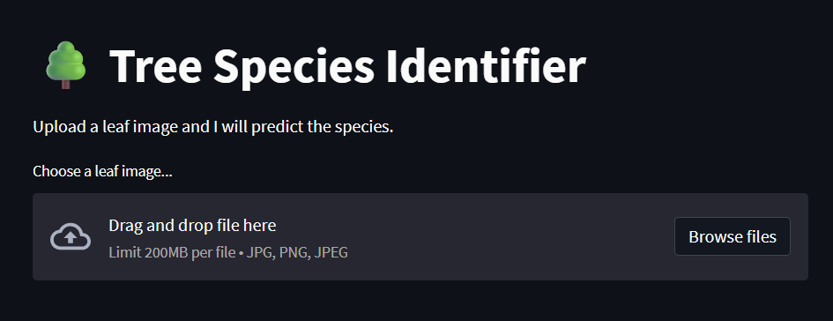
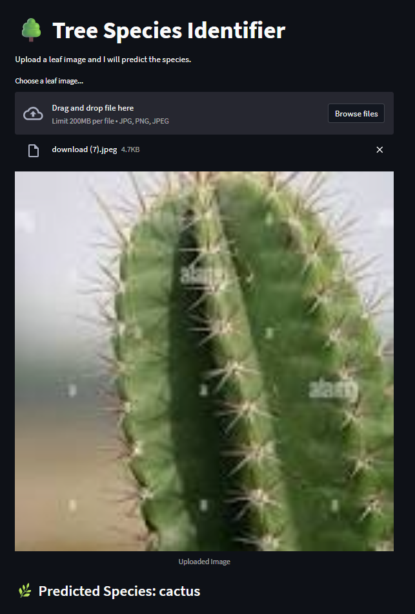
Screenshot of Output:
Fig.2
Tree species identifier Output Prediction
Fig.1
Tree species identifier web app deployment

Slide 8
Dataset Overview:
📦 Source: Kaggle – Tree Species Identification Dataset
🔢 Total Classes: 31 tree species (e.g., neem, mango, banyan, gulmohar, etc.)
🖼️ Format: Folder-based image dataset — each folder represents one class
📏 Size: Thousands of labeled images

Slide 9
Data Preprocessing:
✔️ Removed corrupted or unreadable image files
✔️ Ignored system folders (e.g., .git)
✔️ Resized all images to 224×224 pixels
✔️ Normalized pixel values to improve training
✔️ Verified consistent folder structure for compatibility
.
🔄 Data Augmentation
Used Keras ImageDataGenerator to improve generalization:
🔁 Horizontal & vertical flips
🔄 Rotation (±15 degrees)
🔍 Zoom in/out
📦 Width & height shift
🌈 Brightness variation
✅ Helps prevent overfitting and improves model robustness

Slide 10
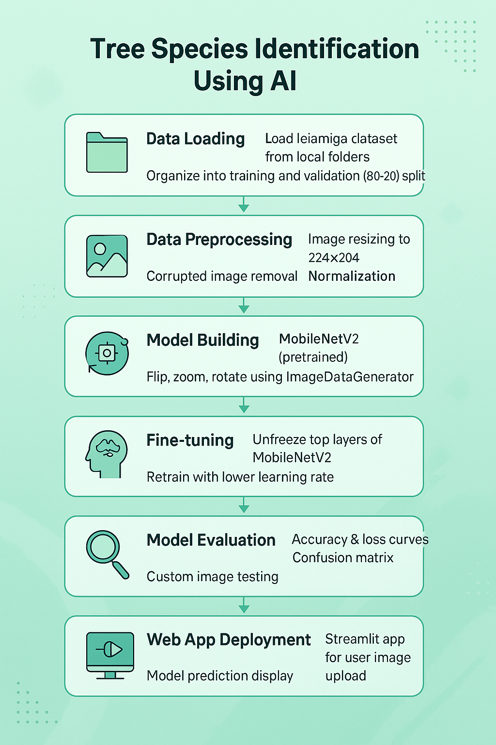
Model Architecture:
📁 Data Loading: Leaf images are organized in species-specific folders and split into training and validation sets (80/20).
🧹 Data Preprocessing: Images are resized to 224x224, normalized, and any corrupted files are removed.
🔄 Data Augmentation: Techniques like flipping, zooming, and rotating are applied to increase dataset diversity.
🧠 Model Building: A MobileNetV2 model is used as the base, with custom dense layers added for classification.
🔧 Fine-tuning: The top layers of MobileNetV2 are unfrozen and trained at a lower learning rate to boost performance.
📊 Model Evaluation: Accuracy, loss plots, and confusion matrices are used to assess performance.
🌐 Streamlit Web App: A user-friendly app allows image uploads and displays real-time species predictions using the trained model.

Slide 11
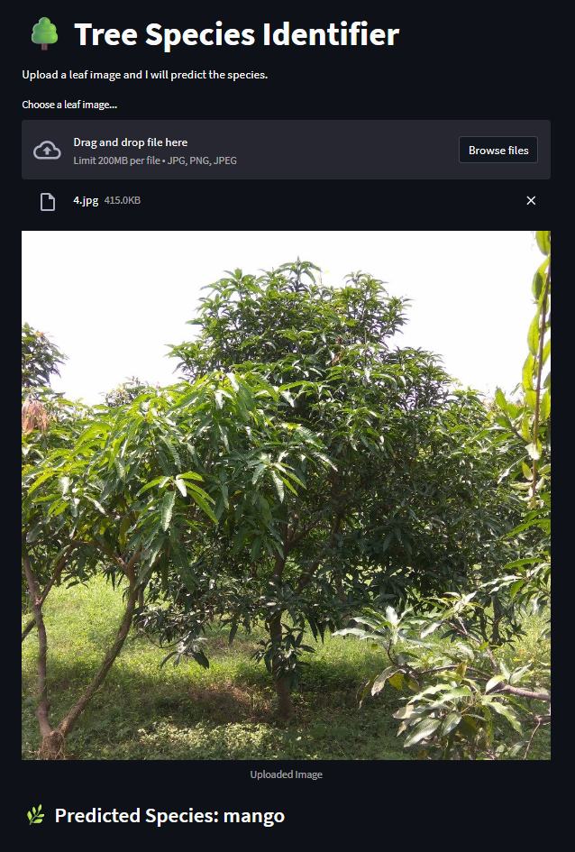
Testing on Custom Images:
📁 Real-world Testing:
- User uploads a leaf image via the Streamlit interface
- Image resized and normalized automatically
- Model predicts class using trained weights
- Outputs tree species name instantly
✅ Example Use Case:
"Upload a mango leaf → Model predicts: mango"
💡 Demo showed good performance on unseen images

Slide 12
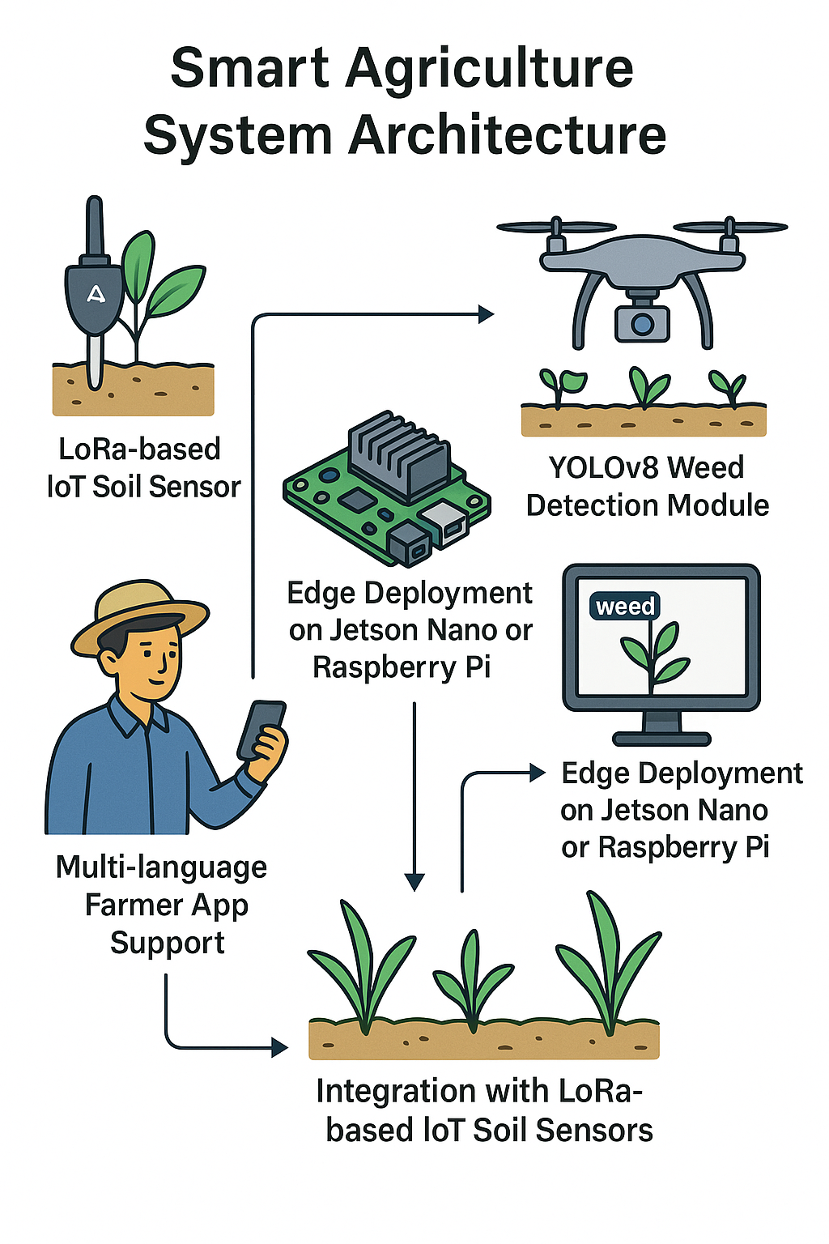
Future Work & Improvements:
🔮 Add a tree recommendation module based on soil & climate data
📊 Improve class balance with techniques like SMOTE
📈 Boost accuracy with further fine-tuning and more data
🌐 Deploy as a full web or mobile application
📲 Enable real-time camera predictions for field use
✅ Vision: Make tree identification and planting smarter, faster, and accessible to all

Slide 13
Conclusion:
The tree classification model achieved ~70% validation accuracy using transfer learning. It was successfully deployed via a Streamlit app for real-time leaf identification. This project lays the foundation for future ecological monitoring tools, including tree recommendations based on soil and climate conditions.

